Slide 1
Support of democracy in Ukraine
Findings of an Opinion Poll conducted in July 2014
GfK Hungária
Budapest, 16 December 2014
Notes:
During the last months, Ukraine has been at the center of the international community’s attention. Although the recent discourse is dominated by the conflict in the Eastern part of country, the democratization discourse should not be put aside, since it has been shown that democratization can ease these kinds of conflicts. Moreover, it is important for the Visegrad countries to have a democratic neighbor.
In this survey the subjective side of democratic consolidation has been observed. The development of democracy does not only require institutionalization of democracy, but it also highly depends on the democratic values of citizens, whose active participation is crucial. Widespread democratic attitudes have the ability to reduce authoritarian alternatives. Whereas, existing nostalgia for the old authoritarian regime may make headway for dictatorship.
Democratic attitudes are introduced according to two aspects. Firstly, this study compares Ukrainian citizens’ democratic values to public opinion in the Visegrad countries. These countries share similar historical backgrounds. Ukraine was part of the Soviet Union and the V4 (Visegrad four) were transformed into satellite states, therefore, both of them still bear the traces of the communist dictatorship. However, the differences before state socialism and the diverse trajectories of the post-socialist transformation caused deep differences between these countries in terms of democratization. In addition to the international comparison, the tendencies of the public opinion over time are also observed. Therefore this survey also examines how Ukrainians’ opinion on the issue of democracy has changed in the last decades.
Finally, three theories are introduced that can explain democratic attitudes. With the help of these theories, stratification of democratic attitudes within Ukraine is also observed. Firstly, basic demographic variables (ethnicity, age, gender, education and region) are used as exploratory variables. Secondly, experiences with democracy are observed. And thirdly, the role of information in support of democracy is introduced.
The data used for this analysis came from 2 sources. On one hand, there were representative surveys conducted between 1990/91 and 1999 in all CEE countries within the NDB. On the other hand, GfK conducted surveys concerning democratic values in Hungary, Poland and Slovakia in 2011. In Ukraine, the same questions have been asked in July 2014. Using these datasets, Ukrainian attitudes can be compared with the ones in the Visegrad countries and also perceptions are traced over time.

Slide 2
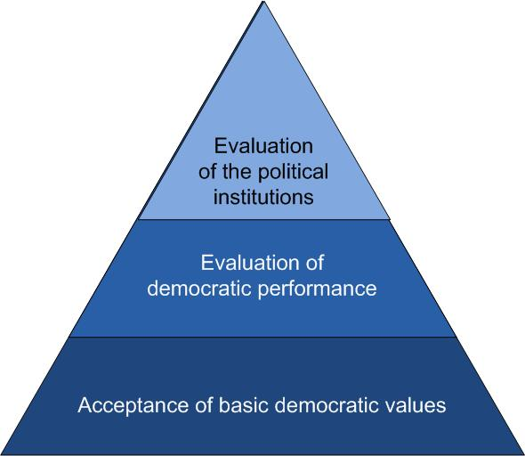
A Theory concerning Support of Democracy
Robert Dalton (2003) distinguishes three main pillars of democratic support.
According to his theory these three pillars are interrelated. Consequently, continuous dissatisfaction with the performance of political system has a negative effect also on the acceptance of democratic values.
Notes:
2
2
The current theory of democracy (e.g. Norris (1999) and Dalton (2003)) distinguish three main pillars of democratic values. The first pillar is the acceptance of basic democratic values. The second pillar is the evaluation of the democratic performance. And the last and most specific pillar is the evaluation of political institutions. Norris and Dalton have argued that these three pillars are interrelated. Consequently, continuous dissatisfaction with the political system has a negative effect on the support of democracy.

Slide 3
Support of Democracy in Ukraine and V4 countries
Ukraine
Poland
70%
Democracy is preferable to dictatorship under any circumstances
62%
Hungary
66%
Slovakia
62%
For people like me, it makes no difference, whether we live in a democracy or a dictatorship
10%
14%
11%
14%
In some cases, dictatorship may be preferable to democracy
18%
11%
17%
21%
Don’t know
10%
5%
6%
4%
Notes:
3
Under the acceptance of basic democratic values two main elements can be distinguished: (1) support of democracy and (2) support of alternative regimes. Scholars have argued that democratic regimes can be evaluated as consolidated when "a strong majority of public opinion, even in instance of major economic problems and deep dissatisfaction with incumbents, holds the belief that democratic procedures and institutions are the most appropriate way to govern collective life, and when support for antisystem alternatives is quite small or more or less.
The support of democracy is measured by asking whether the respondent prefers democracy to dictatorship or not In Ukraine the rate of people who prefer democracy to dictatorship does not lag behind the Visegrad countries. The concept of ‘strongly antidemocrats’ refer to those who prefer dictatorship to democracy. These rates show a similar pattern in Ukraine as in the Visegrad countries. This result indicates that support of democratic values is similar in Ukraine and the Visegrad countries.

Slide 4
Change in Support of Democracy in Ukraine between 1999 and 2014 (%)
Notes:
Despite the fact that recently Ukraine and the Visegrad countries do not differ in terms of support of democracy, they have had very different trajectories in the last few decades. Since 1999, Slovakia and Hungary have experienced a moderate decline while Poland has seen some development in terms of support of democracy. In contrast, Ukrainian support of democracy has increased by almost 25 percent since 1999, while support of dictatorship has fallen by 14 percent. This result indicates that the recent relatively strong support of democracy in Ukraine has occurred during the last 15 years.

Slide 5
A Typology evaluating Support of Democracy
A fourfold typology concerning support of democracy is based on questions: 1) Democracy is preferable to dictatorship under any circumstances… and 2) Democracy is capable of dealing with the problems country faces (Linz / Stephan)
Confident democrats prefer democracy to dictatorship AND are convinced that democracy is capable of dealing with problems
Worried democrats prefer democracy BUT have doubts about its problem solving capability
Alienated people are indifferent to the type of government
Authoritarians prefer dictatorship over democracy
worried democrats
confident democrats
authoritarians
alienated
Notes:
5
5
A typology has been developed in order to gain deeper understanding of democratic orientations. It relies on two variables: (1) whether someone supports democracy or not and (2) whether this person believes that democracy is capable of solving crucial problems in the country or not. Based on this typology, four groups can be distinguished: (1) confident democrats who prefer democracy to dictatorship under any circumstances and are convinced that democracy is capable of dealing with problems. (2) Worried democrats who prefer democracy, however, have doubts about its problem solving capability. (3) Alienated individuals who are indifferent to the type of government and finally (4) authoritarians who prefer dictatorship over democracy.

Slide 6
Changes in Population’s Attitudes toward Democracy between 1999 and 2014
Notes:
This typology provides an opportunity to further observe the composition of society according to their democratic attitudes. In the Visegrad countries ‘Confident Democrats’ constitute the absolute majority (66 percent in Hungary, 59 percent in Poland and 56% in Slovakia). In contrast, less than half of the respondents in Ukraine (47 percent) preferred democracy to dictatorship and believed that democracy is capable of dealing with the problems facing the country, however the rate of ‘Worried Democrats’ is remarkably high. 23% of the Ukrainians preferred democracy but did not believe that democracy is capable of dealing with the problems facing their country. The number of ‘Worried Democrats’ is so high in Ukraine that it outnumbers ‘Authoritarians’, whereas in the Visegrad countries the ‘Authoritarians’ constitute the second largest group after ‘Confident Democrats’. Thus, the results indicate that Ukraine does not lag behind in terms of preferences for democracy, however, one third of the democrats believe that this political system cannot deal with problems.
This typology can observe tendencies over time, as well. The rate of ‘Confident Democrats’ has risen in every observed country. However, the Ukrainian change in rate of ‘Worried Democrats’ largely differs from the change measured in the Visegrad countries. In the Visegrad countries there has been a fall in this category, whereas, in Ukraine this category has risen by 11 percent. Thus, in Ukraine, while a growing number of people prefer democracy, many of them do not believe that it can solve crucial problems.

Slide 7
Satisfaction with Democracy
Notes:
Satisfaction with democracy is the second pillar of democratic attitudes. Democracy is obviously in danger if the majority of the citizens are not content with the political system. As such, a stable democracy requires a certain level of satisfaction. It is also important to note that satisfaction with democracy tends to be lower than the support of democracy since the previous concept refers to a more specific issue.
Ukrainian satisfaction with democracy in 2014 has been compared to the Polish, Hungarian and Slovakian citizens’ satisfaction in 2011. Twenty-two percent of Ukrainians reported that they are very satisfied, along with 25% of Hungarians, 35% of Slovaks and 45% of the Polish population. The results show that the Ukrainians are slightly less satisfied than Hungarians, but they showed much lower level of satisfaction than the Polish or the Slovak population. So the Ukrainians do not differ from the citizens of the Visegrad countries in terms of support of democracy, however, they reported lower satisfaction with democracy. This result may explain the relative low level of ‘Confident Democrats’ in Ukraine.
The reliability of the question that measures satisfaction with democracy has been severely challenged on multiple occasions. Some scholars have argued that it is not clear whether the respondents were talking about the regime, the state or the government when they answered this question. Therefore, the evaluation of the democratic performance is highly connected to the evaluation of governmental performance. Furthermore people who are satisfied with democracy are the ones who prefer this regime to state socialism. Therefore the evaluation of the recent regime, the communist regime and the system change should also be analyzed.

Slide 8
Strong Nostalgia vis-a-vis Old Regimes
The communist era had mostly or only bad sides:
HU: 12%
PL: 24%
SK: 20%
UA: 12%
The communist era had mostly or only good sides:
HU: 41%
PL: 13%
SK: 31%
UA: 52%
The communist era had both bad and good sides:
HU: 47%
PL: 52%
SK: 43%
UA: 27%
Notes:
Ukrainians professed higher nostalgic feelings toward the communist regime than people from the Visegrad countries. Fifty-two percent of the Ukrainians reported that they had experienced or heard mostly good things about the communist regime, whereas in Poland only 13%, in Slovakia 31%, and in Hungary 41% of the citizens expressed positive memories towards the communist era. Similarly, Ukrainians attached more disappointment to the system change. Only 5% of the them reported that the system change exceeded or fulfilled their personal expectations. These results are the same in Hungary, however, Poles and Slovaks had better experiences with the system change (10% of them said that system change exceeded or largely fulfilled their expectations). To sum up, Ukrainians had lower satisfaction with the recent government and they also expressed higher positive feelings toward the communist system. This result may explain the relatively low level of satisfaction with democracy.

Slide 9
Trust in Institutions (% of people having trust)
 | Hungary | Poland | Slovakia | Ukraine
Government | 23 | 19 | 23 | 23
Parliament | 22 | 21 | 21 | 10
Political parties | 12 | 11 | 14 | 9
President | 30 | 40 | 51 | 45
Courts of law | 38 | 40 | 28 | 6
Police | 42 | 47 | 34 | 7
Army | 38 | 58 | 53 | 46
Churches | 22 | 27 | 27 | 50
Public television | 38 | 40 | 28 | 27
Private televisions | 42 | 47 | 34 | 26
Notes:
Since citizens tend to equate democratic performance with the performance of political institutions trust in institutions is one of the most widely used indicator of specific support. Democracy requires a certain level of trust because “deficit of trust” generates a huge problem since citizens are more and more reliant on large-scale social systems and only trust can solve numerous collective-action problems.
The average levels of trust in political institutions are slightly lower in Ukraine than in the Visegrad countries. This average in Ukraine (in 2014) was 26%, whereas it was between 31% and 36% in the observed Visegrad countries (but 3 years earlier).
In Ukraine the evaluation of executive institutions were much worse than in the Visegrad countries. For example, in Ukraine only 10% expressed trust in Parliament, whereas in the Visegrad countries this rate was 21-22%. Nevertheless, some other institutions enjoyed solid trust: 45% of the Ukrainians trusted in the President, which is higher than the rate in Hungary or in Poland.
Although the media plays an important part in democratic consolidation, Ukrainians had a low level of trust in it. In the Visegrad countries all types of media were badly evaluated except private television. In contrast, Ukrainians found this type of media highly untrustworthy. Only 26% of Ukrainians trusted in the private media, whereas this rate was 42% in Hungary, 47% in Poland and 34% in Slovakia.
The only institution that enjoyed higher level of trust in Ukraine than in the Visegrad countries was the church. Fifty percent of Ukrainians trust in the church, whereas this rate was only between 22% and 27% in the Visegrad countries.

Slide 10
A Causal Model for Explanation of Support of Democracy
influencing factors
age (generations’ effect)
Long-term theories
region (traditions)
ethnic background (language)
education
support of democracy
economic situation (perspectives)
Short-term theories
personal security
rights and liberties
interest in politics
Learning theories
understanding politics
Notes:
10
Potential explanations of democratic attitudes are based on three theories.
Firstly, the long-term theory will be introduced which focuses on childhood socialization. Long-term theories argue that democratic attitudes depend on socialization. Within primary socialization we can distinguish micro and macro factors. Micro factors entail, for example, age, gender, education, region and ethnicity. Macro factors were also analyzed by scholars, such as religious traditions, the length of communist regime and democratic experiences before the soviet regime, but our survey could not analyze those factors. These explanations are focused on the environment in which the individuals have lived, assuming that if two people encountered similar circumstances, they would also have similar attitudes as well.
Secondly, short-term theories that imply temporary evaluation will be detailed (e.g. evaluation of the government’s work). The second group of explanations emphasizes individuals’ experiences. This theory states that support of democracy depends on short-term evaluation of democratic actors. This approach states that democratic attitudes are constantly changing (even within one generation). This change occurs every time the efficiency and/or effectiveness of the regime changes.
There are several ways to measure the efficiency of the system. Some theories emphasize the importance of economic development. Dalton, for example, has argued that widespread support of democracy requires economic development. The observed countries faced dramatic decline in their economies after the fall of the Berlin wall, which caused a decrease in support of democracy. There are many people in the Visegrad countries that still blame democracy for the economic difficulties that their countries face, a quarter of a century after the change in political systems. Therefore, the observation of the effect of the economic situation on democratic attitudes is highly relevant. Furthermore perceived existence of individual rights and freedoms are also able to affect the rates of support of democracy. The above factors are often conceptualized as economic and political outputs of the system. Beyond that, also the perceived personal security can have a role in system evaluation.
And finally, the learning theory emphasizes the importance of information gathering in addition to primary socialization and the evaluation of the current performance. This new theory stresses that information can also play a crucial role in the formation of democratic attitudes. Therefore, understanding politics plays an important role in supporting democracy.

Slide 11
Support of Democracy – A Question of Generations?
Notes:
First of all the generational effect has been tested. Empirical results show that in Ukraine, age has a significant effect on support of democracy. The rate of people who prefer democracy over dictatorship was the highest among middle-aged people (75%), followed by the people who are below 30 years (72%), while the lowest rate was among people over 60 years (61%). At the same time, younger people have approximately the same likelihood to fall under the category of ‘Confident Democrats’ as middle-aged respondents. Moreover, younger people would less likely to say that they prefer dictatorship to democracy. This means that the generation, which was born after the fall of the Berlin wall, supports democracy a bit less than their parents but they reject dictatorship more than the older generations. In contrast, in the Visegrad countries there are no significant differences between the generations. This result indicates that political socialization works slightly better in Ukraine than in the Visegrad countries over the last two decades.
Nevertheless, educational attainment has a no effect on support of democracy.

Slide 12
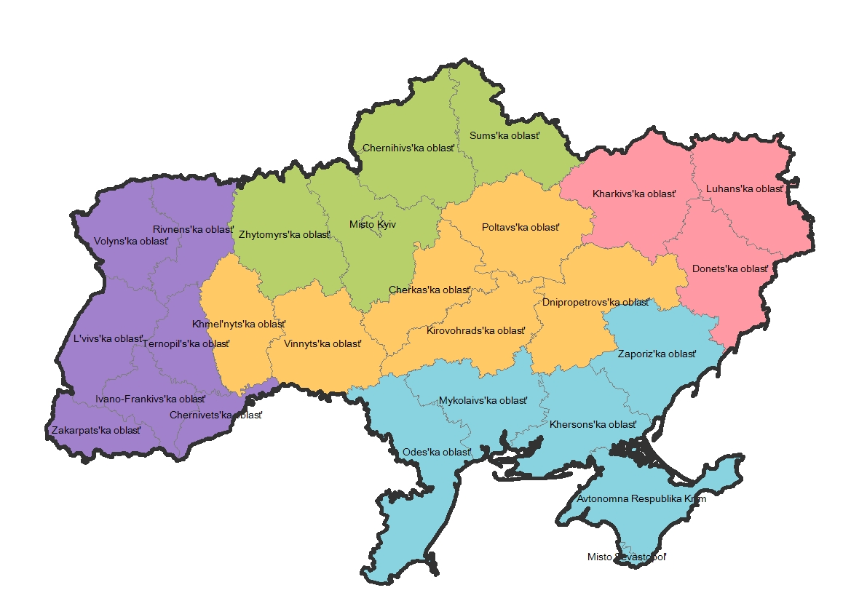
Support of Democracy – Strong Regional Differences
North Ukraine – 67%
Western Ukraine – 81%
Eastern Ukraine – 53%
Central Ukraine – 61%
Southern Ukraine – 46%
Notes:
Traditionally two parts of Ukraine can be distinguished: Eastern and Western Ukraine. The West is largely influenced by Poland while Russians have traditionally dominated the East of the country. Our data indicates that region has perhaps the strongest effect on the support of democracy: there is a sharp difference between the Western and the Eastern regions. Eighty-one percent of the respondents in the Western region prefer democracy to dictatorship, which is actually much higher than in the Visegrad countries. In contrast, only 46% of the people living in the Southern region and 53% of the people living in the Eastern region expressed democratic attitudes. The rates in the Northern and the Central region fall in between the Western and the Eastern rates.
Moreover, the Western region exceeds the Eastern one in terms of the number of ‘Confident Democrats’, but the rate of ‘Worried Democrats’ does not differ from one region to the other. This means that not only do Western citizens prefer democracy over dictatorship, but also in the West, people believe that democracy is more capable of dealing with the crucial problems of the country.
The Ukrainian regions largely differ in terms of ethnic composition. Western Ukraine is dominantly inhabited by ethnic Ukrainians, while ethnic Russians are concentrated in the Eastern and Southern parts. Our sample indicates the same sharp difference. In the Western region 96% of the population said that they primarily speak Ukrainian, whereas in the Eastern region it was only 3%. The results of multivariate analysis (binary logistic regression) show that ethnic background and language have no influence on democratic attitudes after controlling for basic demographic variables, i.e. Russian and Ukrainian speaking respondents from a given region, with the same age and economic situation have the same probability to have democratic or antidemocratic values.

Slide 13
Support of Democracy – a Question of Welfare?
People with negative economic expactations
51%
People with neutral economic expactations
59%
People with positive economic expactations
71%
Notes:
13
Analyzing the short-term factors, we have seen that the economic situation of the individual influences his or her democratic attitudes. The financial situation was measured by three questions (concerning the actual living conditions, the changes in financial situation during the last years and expectations for the next years). Only the effect of expected changes in financial status is significant. Those people who had the most democratic attitudes are the ones that expected improvement in their financial situation in the following 10 years. The dataset also makes it possible to observe perceptions as to whose duty it should be to guarantee welfare. Thirty-eight percent of people from the Visegrad countries thought that the state should be responsible for the welfare of its citizens, which is much higher than in Western countries. In the Visegrad countries the high level of dissatisfaction with the system change can be attributed to the fact that citizens think that the state is too weak. In Ukraine the state is considered to be responsible for welfare to an even higher degree than in the Visegrad countries. Fifty-six percent of Ukrainians think that the state should be responsible for everyone's economic security. Besides that, those people who think that the state should be responsible to guarantee welfare tend to be more antidemocratic than those who believe that individuals should be responsible for their own welfare.

Slide 14
Other Factors influencing Support of Democracy
1
Public security
Preference for dictatorships taking into account responses given for question „Do you feel safe when you get out on the street?”
definitely – 9% somewhat – 20%
not much – 26% definitely not – 27%
Evaluation of system performance concerning rights and liberties
2
Existence of 10 rights and freedoms have been asked for (e.g. right to elect authorities, to participate in demonstrations, etc.)
Rate of people supporting democracy:
9 to 10 rights – 78%
4 to 5 rights – 64%
1 to 2 rights – 46%
Information, interest in, understanding of politics
In Ukraine, the level of interest in and understanding of politics is very high compared to V4 countries (e.g. 37% of Ukrainians are very interested but only 9% of Slovaks), however, there is no evidence that more interested people would be more democratic.
3
Notes:
Beyond the financial security, also the evaluation of personal security influences the support of democratic system. Respondents assessing the public security in their neighborhood unsafe have higher chance to prefer a political system with stronger control. While people feeling safe on the street opt for dictatorship with a probability of 9% only, those anxious about public security choose dictatorship with much higher acceptance.
As we have seen, some scholars argue that satisfaction with the political output of the democratic system also matters in support of democratic attitudes. The survey makes it possible to observe to what degree the respondents think that individual rights and liberties exist in Ukraine (e.g. right to freedom of speech, right to elect authorities, etc.). Based on these items, an index was calculated. This index takes a higher value if someone believes to a higher level that individual rights do exist in Ukraine. Those people who had higher value on this index tend to have stronger support of democracy as well. This result indicates that perceived efficiency of the democratic system correlates with higher support of democracy.
Concerning learning theories, we found that in Ukraine, a lower rate of citizens said that they sometimes do not understand politics. In the Visegrad countries approximately 75% of the people had some problem with understanding politics, whereas this rate was only 59% in Ukraine. Moreover, in Ukraine, the number of people who said that they understand the problems of their own country was also higher than the number of people in the Visegrad countries. Therefore, internal affairs within politics are more understandable for Ukrainians than for the citizens from Visegrad countries.
Besides the fact that Ukrainians claim to understand more politics than the citizens of the Visegrad countries, they are also more interested in politics. In Ukraine 37% of the people said that they are very much or much interested in politics, whereas only 23% of Hungarians 12% of Poles and 9% of Slovaks expressed such a strong interest in politics. Of course, that high interest in politics among Ukrainians may be the consequence of the recent turbulent political situation in the country.

Slide 15
Strong Procedural Legitimation
Poland
73
Percentage of respondents
evaluating voting in parlamentary
elections important
Ukraine
76
Slovakia
72
Hungary
75
Notes:
15
The learning theory claims that attention should be paid not only to the primary socialization, but also to the socialization that occurs later in life. Mainly two forms of political participation can be distinguished. The first is (1) voting in elections. The second one is (2) ‘civil engagement’ which contains all political activity that goes beyond voting.
One of the important pillars of democracy – voting in elections – is “in principle” internalized by a great majority. If not always in practice as some low turnouts in election-participation shows, at least as a norm. Around three quarters of the population consider voting in parliamentary elections “important”.
According to the IDEA data (2014) the Ukrainian voter turnout for parliamentary elections is approximately on the same level as the turnout in the Visegrad countries (although, there are large differences also within V4 group, see for example the last results of Poland and Hungary, with 49% turnout for the former and 62% for the latter). Therefore, there is no big gap between the Visegrad countries and Ukraine in terms of the number of voters participating in the election. However in both of these countries a decreasing tendency over time can be traced. In Ukraine every parliamentary election has had fewer and fewer participants than in the previous years. In 1994 76% of the population voted, whereas in 2012 only 57% of the population expressed their point of view through voting.
The second field of political participation is civil engagement. Bratten and Mittes (2004) have argued that different political and cultural institutions can shape public opinion. For example, churches, political parties and civil organizations can have a huge impact on individuals. Several scholars have argued that a strong civil organization is the key to a good working democracy but this concept could not be evaluated on the basis of our data.

Slide 16
A Causal Model for Explanation of Support of Democracy
influencing factors
3. age (generations’ effect)
Long-term theories
1. region (traditions)
ethnic background (language)
education
support of democracy
2. economic perspectives
Short-term theories
5. personal security
4. rights and liberties
interest in politics
Learning theories
understanding politics
Notes:
16
The causal analysis carried out was able to verify or falsify some hypothesis and theories concerning the factors influencing support of democracy in Ukraine. As a summary, we can make it clear that regions have the strongest effect, after that the economic perspectives of households, the age, the satisfaction with the political output of the system, and last but not least the perceived personal security contribute to the support of democracy. The other factors (like education or ethnical background) have no own effects.

Slide 17
Further Development is Uncertain
Conflicting effects:
very strong democratic values in Ukranian society
compared to Visegrad countries, there is no lag concerning support
people have strong interest in politics
BUT
very low satisfaction with system performance
strong nostalgia toward communist regime
practically no trust in institutions
Notes:
The results indicate that the Ukrainian support of democracy does not lag behind the Hungarian, Polish, and Slovak ones. In the beginning of the 21th century the difference between Ukraine and the Visegrad countries were significant, but since then, the gap between them has narrowed. However, the rate of ‘Worried Democrats’, those people who prefer democracy but do not think that it is capable of dealing with the crucial problems of the country, was remarkably high in Ukraine compared to the Visegrad countries.
To sum up, we can say that the support of democracy in Ukraine does not lag behind the Visegrad countries due to rapid Ukrainian development. However, satisfaction with democracy is much lower in Ukraine. This phenomenon probably can be attributed to the fact that Ukrainians gave negative assessments regarding the recent regime while having higher nostalgic feelings towards the past communist regime. Also, Ukrainians have expressed low trust with their country’s political institutions, except for the presidency. Several scholars have argued that citizens cannot distinguish the difference between the political system and the government. As such, the low level of satisfaction with democracy can be attributed to the fact that Ukrainians give poor evaluations of the recent regime but have higher nostalgic feelings toward the communist regime. Furthermore Ukrainians have lower trust in political institutions than citizens from the Visegrad countries.
Based on the above facts, the newly elected Ukrainian democratic power can start to govern enjoying a strong popular support, however this legitimacy may easily become fragile if people will not experience in their everyday life that the new regime performs significantly better than the previous ones, so it deserves more trust than the predecessors.

